Slide 1
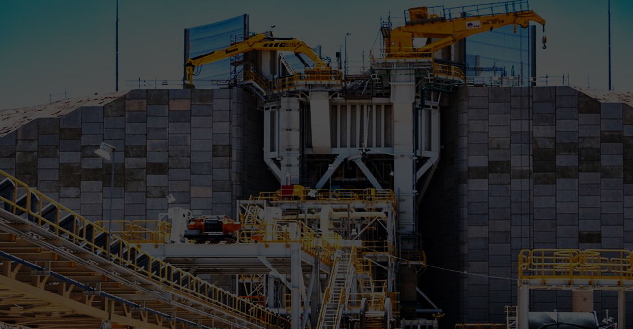
Sponsorship
Prospectus
November 19-21, 2023 | Vancouver, Westin Bayshore

Slide 2
Why sponsor the CIM Capital Projects Symposium
First and foremost, this symposium is the only global industry event that focusses 100% on mining projects. Internationally, our industry is heavily criticized for not being able to deliver successful projects and supporting this symposium will help us all deliver better project results and improve our global reputation. That alone is a reason to get involved.
Having your corporate brand attached to this symposium shows your interest to help improve capital project delivery in mining. Your branding will be front and center for potential clients, employees, financiers, and other industry professionals to see and identify your organization’s expertise and interest in delivering successful projects and improving our industry's’ reputation. Sponsoring helps us keep delegate costs low, enabling us to have more people attend and provide a greater impact.
The third edition of this specialty conference is focused on the various elements that result in successful project execution, project development, financing methods, contracting models and execution methods. It’s about people getting together to discuss lessons learned and new ideas and to come up with new ways to safely and successfully execute mine capital projects.

Slide 3
Sponsorship Opportunities Overview
Platinum level sponsor
Gold level sponsor
Silver level sponsor
Exhibitor level sponsor
À-la-carte sponsor
Advertising rates
All logos will be sized to sponsorship level and placed in alphabetical order within their respective level

Slide 4
Sponsorship Matrix
Benefits Level | Platinum (4) | Gold (5) | Silver | Exhibitor (10)
Amount | $13,000 | $7,000 | $3,000 | $2,500
PRE-EVENT
Logo and link to company website on our symposium website | X | X | X | X
Logo in pre-conference program in CIM Magazine | X | X | X | X
Recognition in notifications and eblasts | X | X | X | X
Recognition on CIM’s social media channels | X | X | X | X
AT THE EVENT
Free attendee registrations | 4 | 2 | 1 | 1
Tabletop in the main Foyer (6’ x 3’) | X |  |  | X
Logo on Sponsorship Banner – sized to sponsorship level | X | X | X
Logo in the Conference Program | X | X | X | X
Ad in printed program | Full page | ½ page | ¼ page
Acknowledgement at key social events | X | X | X
Extra tickets for the social event | 2 | 1
Moderating an Expert Panel Session | X

Slide 5
Sponsorship À-la-carte items
À-la-carte items | No. available | Unit price
COFFEE STATIONS DURING TECHNICAL SESSIONS Branded signage at the coffee stations. | 6 | $1,000.00
CONFERENCE PENS Pens with logo to be offered to delegates. **Custom pens to be provided/paid for by the sponsor. | 1 | $1,500.00
CONFERENCE NOTEBOOKS Notepads with logo to be offered to delegates. ** Custom notepads to be provided/ paid for by the sponsor. | 1 | $1,500.00
LUNCH Your logo on signage in front of the room and branded signage at the buffet | 2 | $2,000.00
PRINTED PROGRAM Branded digital preliminary program one month prior to the conference. Back cover of the printed program. | 1 | $5,000.00
WORKSHOPS Two (2) free registration to workshops. Logo on signage. Recognition live at the start of the workshops. Silver level benefits & recognition. | 1 | $6,000.00
BADGES & LANYARDS Logo on conference lanyards and on badge paper. ** Custom lanyards to be provided/ paid for by the sponsor. | 1 | $7,000.00
SOCIAL EVENT (Monday night) Logo on signage and menus. Recognition live at the start of the evening. | 1 | $10,000.00
Please provide your logo or your banner artwork in high resolution (or according to specs) to be used on our digital platforms.

Slide 6
Advertising rates
Advertising rates | Trim | Unit price
FULL PAGE: Spiral bound booklet. Consider a .75-inch spine unsafe text area for full page bleed ads. Please precise if you would prefer a LHP or RHP placement. | 5.5“ (w) x 8.5“ (h) | $1,250.00
½ PAGE | 3.75“ (w) x 4.5“ (h) | $1,050.00
¼ PAGE | 3.75“ (w) x 2.25 (h) | $650,00
INSIDE COVER (FRONT) | 5.5“ (w) x 8.5“ (h) | $1,550.00
INSIDE COVER (BACK) | 5.5“ (w) x 8.5“ (h) | $1,550.00
Ads will appear in the digital preliminary program and in the printed program.

Slide 7
Partnership Agreement
Company: | Mailing address:
Contact Name: | Telephone:
Email address: | Authorized signature:
Our company confirms its participation as:
Sponsorship
Platinum Sponsor ($13,000)
Gold Sponsor ($7,000)
Silver Sponsor ($3,000)
Exhibitor ($2,500)
A la Carte items
1:
2:
Advertisement
Full Page ($1,250)
½ Page ($1,050)
¼ Page ($650)
Inside Cover Front ($1,550)
Inside Cover Back ($1,550)
We understand that the total for the above confirmed purchase(s) will appear on one invoice issued by the Canadian Institute of Mining, Metallurgy and Petroleum (CIM). Applicable taxes will be added.

Slide 8
Contact:
For more information, to discuss opportunities and to send your filled agreement:
Guylaine Richard,
CIM Event Planner
Email: grichard@cim.org
http://capitalprojects2023.cim.org

